Slide 1
PISA, 8-10 MAY 2018
WORKSHOP “SMALL AREA METHODS AND LIVING CONDITIONS INDICATORS IN EUROPEAN POVERTY STUDIES IN THE ERA OF DATA DELUGE AND BIG DATA”
FINAL EVENT OF THE JEAN MONNET CHAIR SAMPLEU
Table 1 Monitoring poverty at a local level – why is it important?
Tiziana Laureti (University of Tuscia - Italy): the estimation of regional prices level : need for comparison and the situation in Italy

Slide 2
The estimation of regional prices level: need for comparison and the situation in Italy
Information on regional price levels is essential for many research questions in regional studies.
Regional values of economic indicators should be adjusted for regional price differentials, following the same logic with which the economic well-being of different countries is not compared without taking into account international purchasing power parities (PPP).
Why?
Estimates of poverty and the standard of living may change substantially with the inclusion of regional price variation.
Price-adjusted estimates of economic indicators should be used in order to avoid misleading regional analyses and related policy implications

Slide 3
The estimation of regional prices level: need for comparison and the situation in Italy
The importance of constructing spatial price comparisons within a country, also referred to as sub-national purchasing power parities, has been acknowledged in literature over the last decade (Laureti and Rao, 2018).
There have been several research projects and studies, carried out by NSOs and individual researchers.
United States (Kokoski , 1991; Aten, 2005, 2006)
Brazil (Aten, 1999; Aten and Menezes, 2002),
India (Coondoo et al., 2004; Majumder et al., 2015)
Australia (Waschka et al., 2003),
United Kingdom (Fenwick and O’Donogue, 2003; Wingfield et al., 2005, ONS, 2011),
Philippines (Dikhanov et al, 2011)
Italy (Biggeri, De Carli and Laureti, 2008; Biggeri, Laureti and Polidoro, 2016; Istat, 2008, 2010, Laureti and Polidoro, 2017)
Western Asia (Skaini and Samara, 2017)
Statistic South Africa (Kelly and Ranoto, 2016)

Slide 4
The estimation of regional prices level: need for comparison and the situation in Italy
However, systematic attempts to compile sub-national PPPs on a regular basis have been hampered by data availability and methodological issues.
Sources of Price Data: to obtain price data from multiple sources and outlets for goods and services that are comparable and representative
A. Data from Consumer Price Indexes (CPIs), calculated by NSOs on a regular basis
CPI samples are selected for temporal not for spatial comparison, complicating the estimation of spatial price differences
B. Ad hoc surveys
In general very expensive for the NSOs
C. Household budget survey data
Demand system based approach (meaningful unit value prices are available only for broadly classified food items)

Slide 5
The estimation of regional prices level: need for comparison and the situation in Italy
Italy is one of the few countries that carried out official experimental sub-national PPP estimations
In 2008 (with reference to 2006 data): GEKS formula, three expenditure divisions (Food and Beverages, Clothing and Footwear, Furniture);
In 2010 (with reference to 2009 data): all COICOP expenditure divisions; GEKS formula and CPD model for actual rents
Istat Project
Within the European Multipurpose Price Statistics project, Istat has been exploring the possibility of using big data (retail scanner data) for compiling sub-national PPPs.
However, scanner datasets provide both opportunities and challenges for price statisticians

Slide 6
The estimation of regional prices level: need for comparison and the situation in Italy
Advantages:
It is recorded what is actually sold and universe of all transactions is considered
Prices available every day of the month and for 1,781 outlets
Detailed information on turnover and quantities for each item code (GTINs)
Territorial coverage is high (all Italian provinces)
A wide range of methods may be used due to availability of quantities and expenditure data
Issues:
Hard discount are not included.
Several sub-classes of food products cannot be considered since these products are sold at price per quantity and are not pre-packaged with GTIN codes (i.e. vegetables, fruit, meat and fresh fish)
High variability of products sold among cities (chaining methods?)

Slide 7
The estimation of regional prices level: need for comparison and the situation in Italy
Open question:
How to combine scanner data with other sources to compile household consumption sub-national PPPs?
traditional CPI data (already representative and in some cases also comparable),
ad hoc collected data for certain groups of products (clothing, furniture, etc.)
data collected on the web also through web scraping techniques.
Is it possible to stimulate the adoption of a unified framework in which price data collections is carried out contemporarily for computing CPIs, sub-national and international PPPs?
Can Eurostat support the compilation of sub-national PPPs within the project “Multipurpose Price Statistics” , launched by the European Commission?

Slide 8
Thank you for your attention!

Slide 9
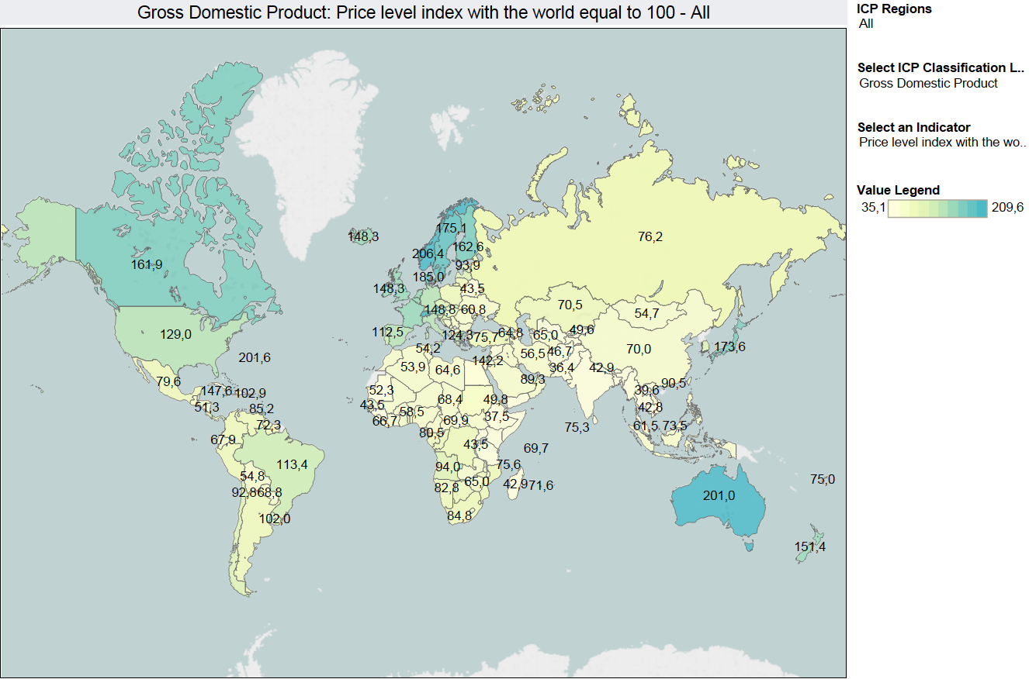
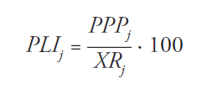
The concept of PPP is used to measure price level in one geographical area compared to that in another area
Sub-national PPPs are needed

Slide 10
References
Biggeri, L., Laureti, T., and Polidoro, F.: Computing sub-national PPPs with CPI data: an empirical analysis on Italian data using country product dummy models. Soc Indic Res, 131(1), pp. 93-121, (2017).
ISTAT: “La differenza nel livello dei prezzi al consumo tra i capoluoghi delle regioni italiane, Anno 2009”, Roma, (2010).
Laureti, T., Ferrante C. and Dramis B. Using scanner and CPI data to estimate Italian sub-national PPPs, Proceeding of 49th Scientific Meeting of the Italian Statistical Society, pp.581-588 (2017)
Laureti, T., and Polidoro, F. Testing the use of scanner data for computing sub-national Purchasing Power Parities in Italy, Proceeding of 61st ISI World Statistics Congress, Marrakech, (2017)
Laureti, T., and Rao, D. P.: Measuring Spatial Price Level Differences within a Country: Current Status and Future Developments. Estudios de economía aplicada, 36(1), pp.119-148, (2018).
World Bank: Purchasing Power Parities and the Real Size of the World Economies-A Comprehensive Report of the 2011 International Comparison Program, Washington, DC(2015)

