Slide 1



Evaluating sustainability through an input-state-output framework: the case of the Italian provinces
Achille Lemmi, Laura Neri, Federico M. Pulselli

Slide 2
State of art
The concept of sustainability requires a multidimensional vision where environment, economy and society are linked

Slide 3
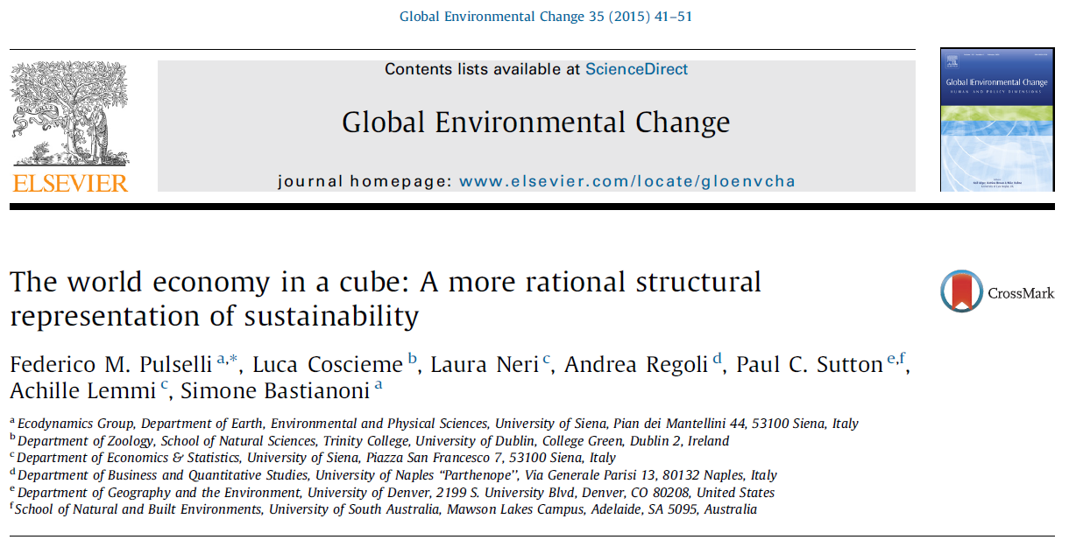
State of art
Pulselli et al.(2015) proposed a very simplified scheme based on:
  input ( the environment provides the system with the necessary resources)
  state (it represents the socio-economic context accounting for the organization and the structure of a system)
  output (it is the economic results of a country)

Slide 4
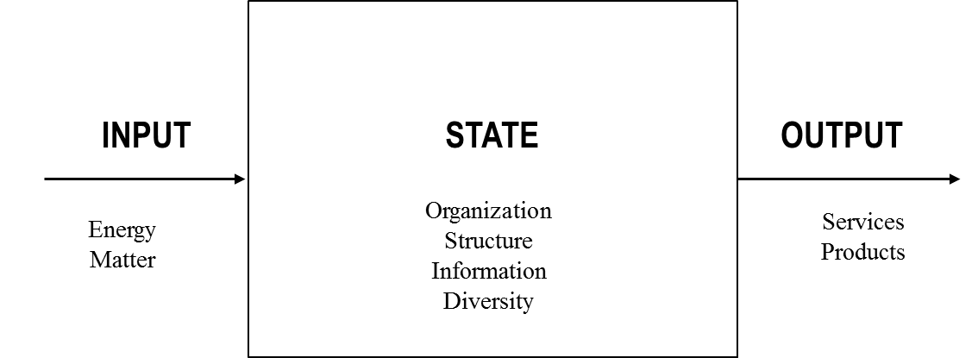
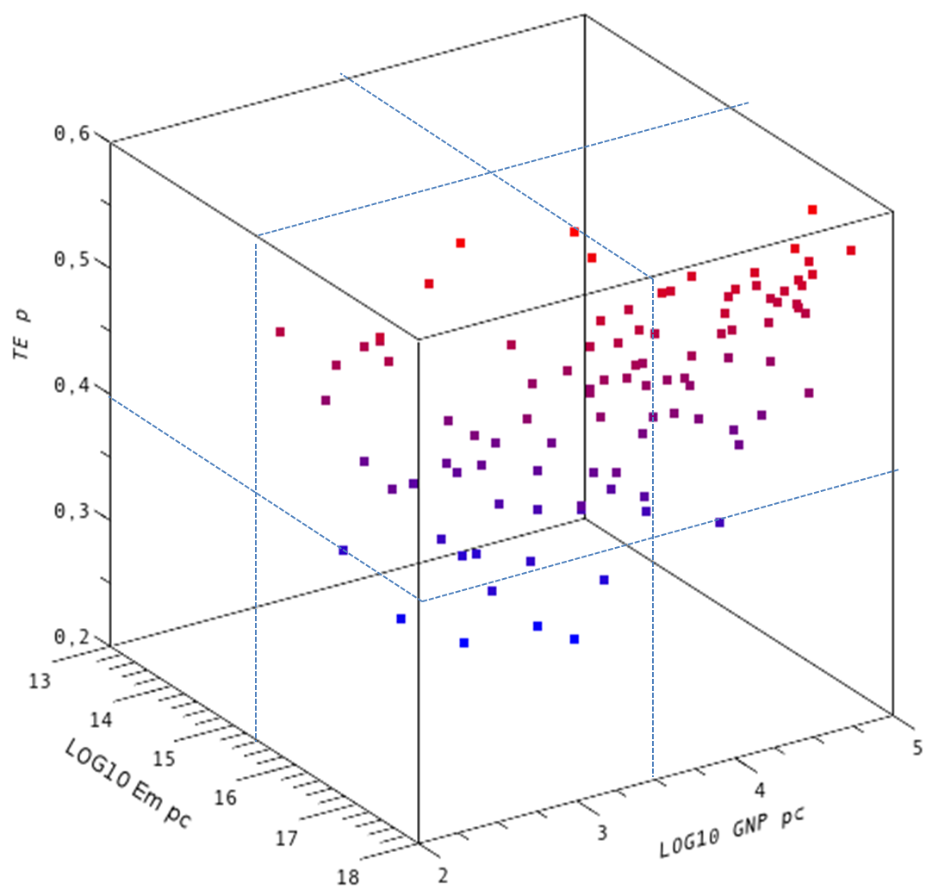
The input-state-output indicator framework
Organization
Structure
Diversity
Work capacity
Measures

Slide 5
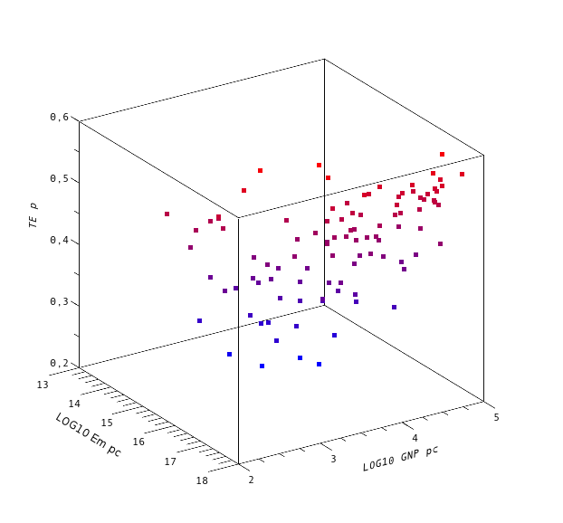
1- GINI
Emergy_{pc}
GDP_{pc}

Slide 6
Just one indicator for each state
Input : Emergy per capita as a measure of energy and matter inputs entering a system
State : Gini index as an indicator of the inequality of income distribution
Output : GDP per capita as expression of the economic performance of the system

Slide 7
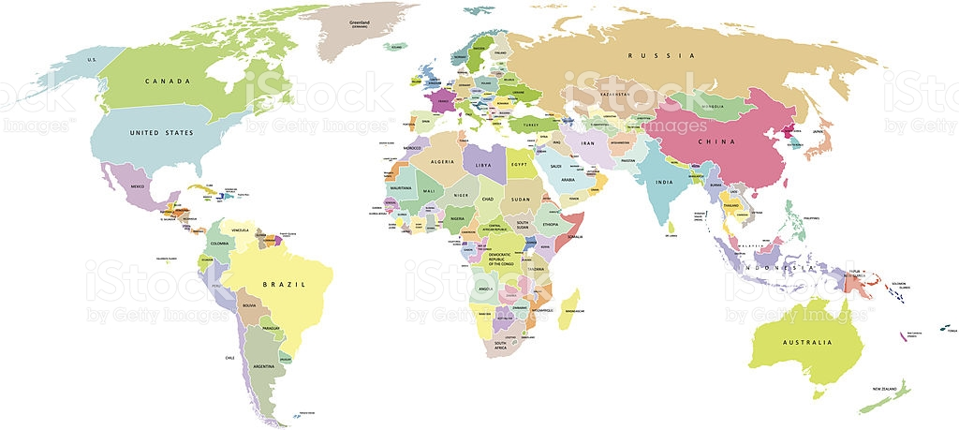
National Economies

Slide 8
Categorization of National Economies through the input-state-output scheme. "low" indicates below-median values; "high" indicates above-median values.
 | Emergy flow per capita | 1 - Gini | GDP per capita | Number of countries
Dissipative | high | low (equal) | high | 30
Unevenly frugal | low | high (unequal) | low | 27
Evenly frugal | low | low (equal) | low | 16
Socially distracted | high | high (unequal) | high | 12
Midas' kingdom | low | high(unequal) | high | 5
Ineffective | high | high(unequal) | low | 5
Inconsistent | high | low (equal) | low | 2
Dematerialized | low | low (equal) | high | 2

Slide 9
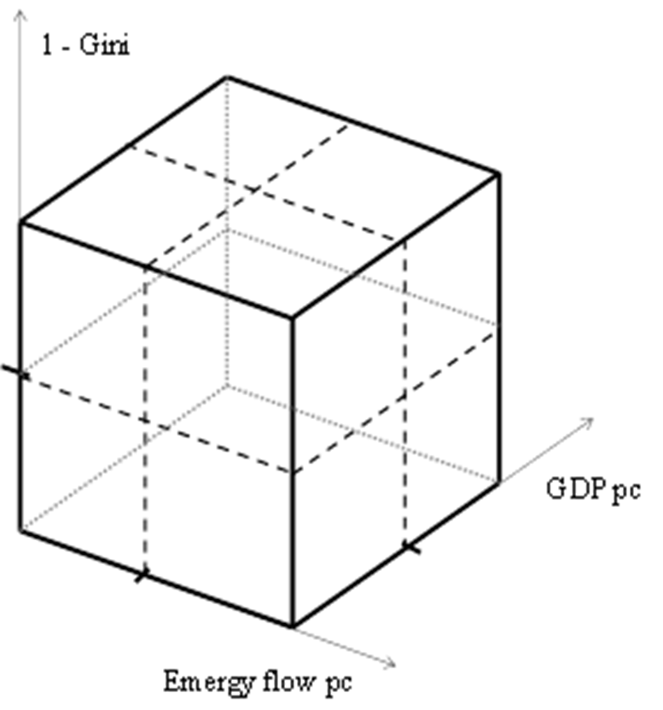
Just Low or High!
A more statistically relevant approach based on the concept of dissimilarity among units instead of using a threshold in order to discriminate between high and low domains.
low
high
High density

Slide 10
Overcoming the drawback of using a crisp threshold like the median
Our goal is to produce
an “objective” classification
of the 99 National Economies
in terms of the three aspects of sustainability
Cluster Analysis

Slide 11
Cluster analysis
The k-median optimization algorithm has been implemented on the three standardized indicators.
The average silhouette index assesses that the partition in four groups can be considered as the best classification since it shows both the highest silhouette index and the greatest homogeneity in the group size.
Moreover
it is consistent with the four "usual" configurations in the cube representation

Slide 12
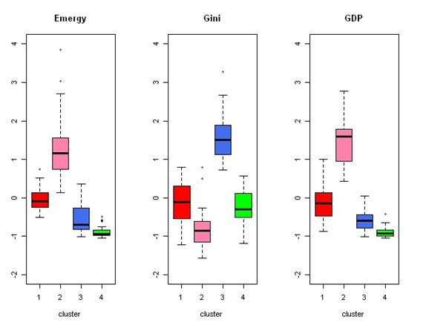
Boxplots of the cluster solution

Slide 13
Cluster 1 the “environmentally, socially and economically medium group of economies”
Countries are geographically heterogeneous, most of them are countries of the former Soviet Union, Eastern Europe countries plus China, Turkey, Greece, Argentina, Uruguay and Venezuela
It is worth noting that this “medium group of economies” cannot be captured by the classification in cubes, indeed the countries belonging to this cluster were scattered in the eight cubes.

Slide 14
Cluster 2 the “strong natural resource dependent with high economic development”
Nearly all high income countries according to the World Bank classification (all Western EU Countries, USA, Australia, New Zealand, Japan and Saudi Arabia).
Gini index lower than the average for all but two countries (USA and UK).
Nearly all the countries were included in the cube of the "dissipative" countries. Because of their high inequality indexes, USA and UK were found in the cube of the "socially distracted" countries.

Slide 15
Cluster 3 “the unequal”
It presents the highest levels of inequality (highest Gini).
It includes countries with lower than average emergy per capita, poor economic performance and strong disparities (Namibia, Nigeria, Rwanda, South Africa, Suriname and Zambia among the others).
Most of the countries belonging to this cluster were classified as member of the "unevenly frugal" cube.

Slide 16
Cluster 4 “lack of resources and the lowest economic output”
Both emergy and GDP stress a very strong omogeneity.
It includes developing African and Asian countries with lack of resources and the lowest economic output, in combination with an average level of inequality.
Most of the countries belonging to this cluster were classified as member of the "evenly frugal" cube (they include India, Egypt, Indonesia, Pakistan, Vietnam, Jordan, Burundi, Cote d'Ivoire, Ethiopia, Morocco, Niger, Senegal, Sudan, Tanzania, Tunisia and Uganda).

Slide 17
Consistency between cubes and clusters
Few nations populate the "unusual" sub-cubes like “ineffective” and “inconsistent” (inefficient users of resources) or (“Midas’ kingdom” and “dematerialized” seeming able to obtain economic wealth without resources
No clusters presenting the characteristics of
high emergy level - low level of GDP or
low emergy level – high level of GDP

Slide 18


Ecological Indicators journal homepage: www.elsevier.com/locate/ecolind
___________________________________________
Evaluating dynamics of national economies through cluster analysis within the
input-state-output sustainability framework
Laura Neri, Antonella D’Agostino, Andrea Regoli, Federico Maria Pulselli, Luca Coscieme
We study the dynamic of the National Economies over 2000 and 2008 for 83 countries. Concluding that: both in a static and dynamic perspective:
dematerialization of the economy has not yet happened
  the economic functioning tends to bypass societal needs to maximize GDP

Slide 19
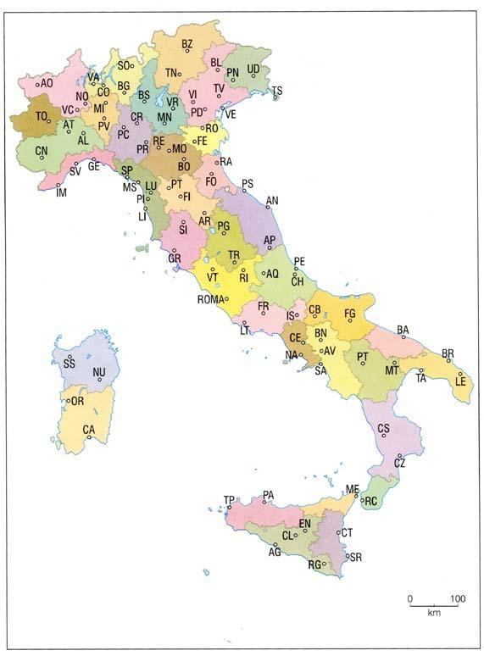
The Italian provinces
According to OECD Regional Well-being (2016) “Italy has the largest regional disparities among the OECD countries in safety, with the Aosta Valley ranking in the top 1% and Sicily in the bottom 10% of the OECD regions. Important regional differences are found also in jobs, environment, community, civic engagement, income and access to services”.
What about provinces?

Slide 20
Our goal
Our goal is to produce an “objective” classification of the Italian provinces (NUTS3) in terms of the three aspects of sustainability.
Due to data constrains, the triad is:
CO2 per unit area (Electricity consumption and sale of a set of fuel types. In order to aggregate these measures, the equivalent in terms of CO2 emission was computed to show both the use of resources (electricity and fuels) and the environmental pressure (emissions), Ministry of Economic Development, 2013)
Unemployment rate (Labour Force Survey, Istat 2013)
GDP per inhabitants (Eurostat, 2014)

Slide 21
Overcoming the drawback of using a crisp threshold for clustering definition
The classification obtained by using the crisp cluster analysis suffers for both a poor homogeneity within group and a lacking separation between the groups
Soft clustering procedure known as Fuzzy Cluster Analysis
Fuzzy sets are used to cluster data, so that each point may belong to two or more clusters with different degrees of membership

Slide 22
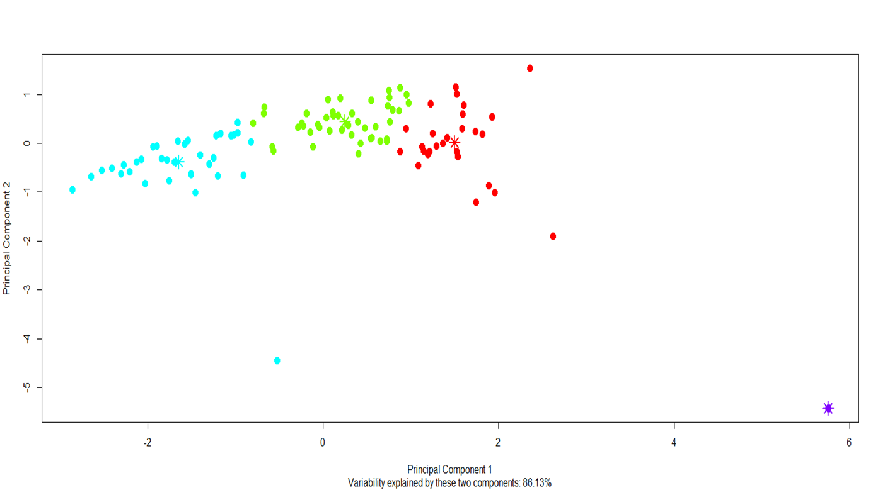
Principal component plot
The clusters are clearly separated but the borderline provinces are very close.

Slide 23
Fuzzy Cluster Analysis
Objects on the boundaries between several clusters are not forced to fully belong to one of the cluster, but rather are assigned membership degrees between 0 and 1 indicating their partial membership.
Objects are assigned to clusters according to membership degrees in [0,1]: 0 is where the data point is at the farthest possible point from a cluster’s center and 1 is where the data point is the closest to the center.

Slide 24
Fuzzy Cluster Analysis
A problem which frequently occurs in real data analysis is the presence of one or more observation presenting anomalous values, i.e. outliers.
Such a subset, referred as noise, tends to disrupt clustering algorithms making difficult to detect the cluster structure of the remaining domain points.
According to Davé (1991) the first k standard clusters are homogeneous, whereas the noise cluster, serving as a “garbage collector”, contains the outliers and is usually not formed by objects with homogeneous.

Slide 25
Fuzzy Cluster Analysis
All data have been standardized before performing the cluster analysis.
The analysis has been conducted by using R and specifically the R package fclust (Giordani, Ferraro, 2018).
The package provide the cluster solution, cluster validity index and plots and also the visualization of fuzzy clustering results.

Slide 26
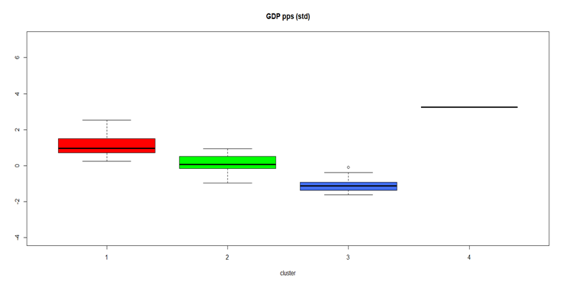
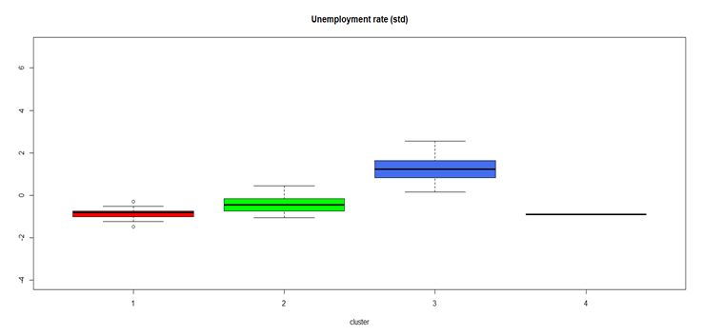
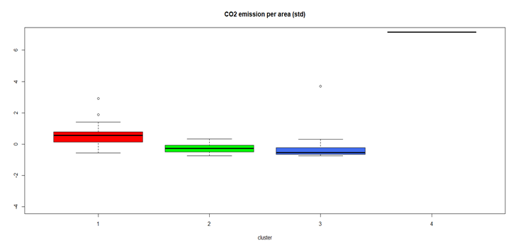
Boxplots

Slide 27
Average values by cluster
Table 1: Size, average membership function and average values for the indicators by cluster
Cluster | size | m.f. | CO2_area | Unempl_rate | GDP_ab
1 | 27 | 0.96 | 2272.88 | 7.75 | 30866.67
2 | 44 | 0.94 | 912.13 | 10.31 | 24854.34
3 | 35 | 0.97 | 804.13 | 19.78 | 17046.71
4 | 1 | 1 | 12755.85 | 7.68 | 44493.13

Slide 28
Cluster | Provinces
1 | Aosta,Bergamo,Bologna,Bolzano,Brescia,Como,Cremona,Firenze, Forlì-Cesena, Genova,Lecco,Livorno,Mantova, Modena,Padova,Parma,Prato,Ravenna,Reggio Emilia,Roma,Trento,Treviso,Trieste,Varese,Venezia,Verona,Vicenza
2 | Alessandria,Ancona,Arezzo,Ascoli,Piceno,Asti,Belluno,Biella,Chieti,Cuneo, Ferrara,Frosinone,Gorizia,Grosseto,Imperia,L'Aquila,La Spezia, Latina,Lodi, Lucca,Macerata,Massa Carrara,Novara,Nuoro,Pavia,Perugia,Pesaro Urbino, Pescara,Piacenza,Pisa,Pistoia,Pordenone,Potenza,Rieti,Rimini,Rovigo,Savona, Siena,Sondrio,Teramo,Terni,TorinoUdine,Verbano-Cusio-Ossola,Vercelli
3 | Agrigento,Avellino,Bari,Benevento,Brindisi,Cagliari,Caltanissetta,Campobasso, Carbonia-I.,Caserta,Catania,Catanzaro,Cosenza, Crotone,Enna,Foggia,Isernia, Lecce,Matera,Medio,Campidano,Messina,Napoli,Ogliastra,Olbia-T.,Oristano, Palermo,Ragusa,Reggio C., Salerno,Sassari,Siracusa,Taranto,Trapani,Vibo Valentia,Viterbo
4 | Milano

Slide 29
Cluster characterization
There are significant disparities among clusters:
Differences going beyond the known geography disparity:
North-Centre (Cl4, Cl1, Cl2,) vs South (Cl3)
Cluster 4 (Milano): CO2 emission per area (more than ten times the average values of all the other provinces i.e.12755.85 vs 1218.29); GDP per capita is nearly double than the average values of all the other provinces (44493 vs 23812).
Cluster 1: 26 provinces located in the North or Central Italy+ Rome. The highest average level of CO₂ per area, the highest GDP per capita and the lowest unemployment rate. Unemployment rate is quite homogeneous within the cluster while the GDP per capita and the level of CO₂ per area present the largest variability.

Slide 30
…cluster characterization
Cluster 2 is the most heterogeneous cluster as regard to the geography of provinces. Composed mainly by North and Central Italy plus
provinces of Lazio (out of Rome and Viterbo) and Abruzzo plus Nuoro
and Potenza. All the provinces in Cluster2, out of Torino, have small medium dimension. This cluster is characterized by high variability in GDP,
ranging from 17900 for Nuoro to 29900 for Siena and low variability in CO2.
Torino presents the lowest membership function (0.55) among all the provinces, being a borderline unit between Cluster 2 and 1.

Slide 31
…cluster characterization
Cluster 3 is composed by whole Calabria, Campania, Molise, Puglia,
Sicilia and Sardegna (out of Nuoro), plus Viterbo (Lazio). This cluster is very similar to the one, labelled as “Minimal system with high social risks” by Bertin (2012) in his classification concerning the welfare state systems of the Italian regions.
Cluster 3 is characterized by the lowest average level of CO₂ emission per area, although such level is biased due to the membership of
Napoli.
As regard to the unemployment rate and GDP, the cluster presents an evident disparity with respect to the others. It is interesting to observe that Napoli is a borderline unit between cluster 3 and 2.

Slide 32
Conclusion
The analysis conducted
  confirm the well-known dualism, resulted in a North-South divide in GDP per capita and in labour-market performance;
  adding a new element: the Southern Italian provinces are quite homogeneous with respect to the considered characteristics whilst the Northern and Central provinces are not homogeneous even if they belong to the same region.

Slide 33
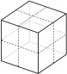
… Thank You for Your kind
ATTENTI N

