Slide 1
Meeting of the International Comparison Program (ICP)
Technical Advisory Group (TAG)
May17-19, 2021
ICP Research Agenda (item07): SubNational PPPs
Estimations of the Subnational Spatial Consumer Price Indices (SN-SCPIs) by using scanner data
(main results of the experiments conducted)
ASESD-“Camilo Dagum” Centre: C. Giusti, M. Pratesi, L. Biggeri, T. Laureti, I.Benedetti;
ISTAT-Unit of Price Statistics: F. Polidoro, F. Di Leo, M. Fedeli

Slide 2
Needs to conduct experiments on
1. The use of scanner data to compute SN-SCPIs
Various experiments have already been conducted but issues:
  essentially based on partial data bases
  various advantages but also disadvantages
  pay much attention as possible to the products and services for which there are no overlapping items in all the different areas
  Comparability vs representativiy and level of comparability to be assured
Need for new experiments with more complete data set
2. The computation of Subnational poor specific SCPIs
3. The collection of information on the main outlets where poor do the purchase (through HES)

Slide 3
The use of scanner data to compute SN-SCPIs
1.1. The characteristics of the available scanner data (Strengths; Weaknesses)
Istat: complete scanner data base of the modern distribution referred to the year 2018 purchased by the market research company ACNielsen
Very detailed information on each transaction: sales; expenditure; quantities and the characteristics of products sold (brand, size, outlet , etc. at the barcode level GTIN (Global Trade Item Number, for thousands of products)
Unit Prices are calculated taking into account turnover and quantities
Weekly prices are obtained as weekly turnover/weekly quantities
Monthly and annual prices are calculated with arithmetic mean of weekly prices weighted with quantities
More than two million prices for over 60,000 products
Deep data cleaning is needed and several outliers

Slide 4
1.1. The characteristics of the available scanner data (Cont.)
Coverage: supermarkets and hypermarkets, especially for food, beverages and personal and home care products
95% of modern retail chain distribution; 55.4% of total retail trade distribution for no perishables and seasonal products; 10,5% in terms of the total expenditures of families for the consumption (share not uniform across Italian territory)
No outlets in rural areas; small shop, local and open market excluded
1.2. Issues coming to assure the complete (“like to like”) comparability
Only 103 over 107 provinces, because of no overlaps across different provinces
Data for 72 BHs; Only 5 out of 12 ECOICOP Divisions
It has been necessary to exclude 7 groups of products.
Difficult to find that equal products are consumed in all the sub-areas, because the consumes of the sub-areas may have very different habits and behaviors in terms of the choice of the outlets and brand of the products
Could be useful to consider homogeneous group of products and all the products purchased by the consumers in the group in the different areas, without reference to the tight comparability.
What it is important is that any product that belongs to the group (also if it is of different brands etc.) satisfy the same consumer’s need
-

Slide 5
1.3 The experiments conducted by using two approaches
The Estimations of the Subnational Spatial Consumer Price Indices (SN-SCPIs) by using two different two different definitions of products’ comparability
The data base used is the same for food and beverage categories and for each of the 103 provinces
WB approach: the principle of comparability is applied in a very tight way by considering the comparisons of the “like to like” items (products) for the different sub-national areas. Computation of the SCPIs for each provincial 53 BHs by using a weighted CPD model and then their aggregation at the provincial SCPIs
ASESD approach: the principle of comparability is applied at the level of group of products, by loosing the tight specifications oat the level of the elementary products. The hypothesis is that the elementary products (items) belonging to each group satisfy in any case the same consumer needs. The groups of product chosen have been at level of the ECOICOP 8-digit classification (that are 102). For each group the weighted average price is computed and the provincial SCPIs is obtained by with the application of weighted CPD model.

Slide 6
Italian Provincial SCPIs computed by using scanner data- Average Italy =1

Slide 7
1.3 The experiments conducted (cont.): General comments
The results obtained are undoubtedly interesting and shown the substantial different level of food’s prices in the Italian Provinces.
The results of the two computations are different and those with WB approach are smoother (without any clear North/ South divide as was expected), than those obtained by ASESD approach.
It is important to take into account that the procedures followed are different too, and that the first estimations could be more influenced by the characteristics of the modern retail trade (and of their sale policy) which is not uniformly distributed across Italian territory.
From simple computation on the correlation between the SCPIs and the value added per capita by Italian province , it is clear that the SCPIs computed according, ASESD approach has higher internal consistency (in fact the correlation coefficient is about +0,60 against -0,10).

Slide 8
2. The computation of Subnational poor specific SCPIs
In order to calculate SPIs closer to the prices paid by the poor, preliminary experiments have been conducted by using the data of the first quintile of the price distributions, assuming that the poor purchase the cheaper items of a product.
After the analysis of price distribution of each product the CPD model was applied to obtain the SCPIs(Q_{0,2}) that is referred to the first quintile of the price distributions, while the general SCPIs(Mean) refer to the all price distributions
The results obtained are reported in the cartogram of the next slide
The results obtained are somehow expected. Indeed, provinces in the south of Italy show SPI smaller than 1, while provinces in the north show values greater than 1. However, there are exceptions.
The value of SCPIs(Q_{0,2}) are smoother than SCPIs(Mean). It seems that the cheaper prices depend essentially on the kind of products purchased in the different outlets and areas.
Need for more information on the purchases of poor?

Slide 9
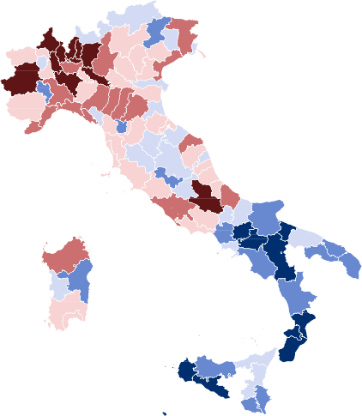
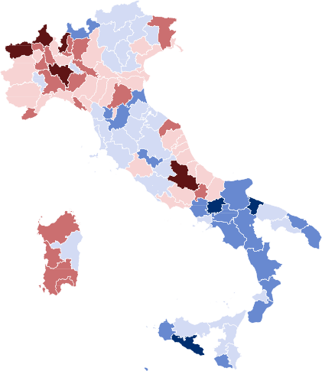
Italian Provincial SCPIs in average and poor specific: computed by using mean unit prices (left) and quantile 0.2 of unit prices (right).
Spatial Price Indicies − ASESD method, Mean
Italian provinces
Spatial Price Indicies − ASESD method, Quant. 0.2
Italian provinces
SPI
SPI
0.9 0.95
1 1.05
1.1 1.15
Data: Scanner data 2017. Source: Istat
0.9 0.95
1 1.05
1.1 1.15
Data: Scanner data 2017. Source: Istat

Slide 10
3. The collection of information on the main outlets where poor do the purchase (through HES)
In 2019, Istat have done a specific analysis of data collected with the Italian Households Expenditure Survey (HES) to know where people in condition of absolute poverty purchase 25 large consumption products.
The households have been divided into two groups: households over (non poor) or below (poor) the thresholds of absolute poverty.
The results obtained from these preliminary analyses of 2019 HES data show some interesting differences between non poor and absolutely poor households in terms of frequency of purchase (poor do purchase with less frequency); and the choice of the type of outlet (poor use mostly traditional shop and hard discount). See the tables
This evidence is worth to be deepened also by breaking down the analysis at territorial level, overcoming the problem of a too small size of the sample if we take into consideration only poor households.
This line of research is aimed at improving the estimation of the actual prices paid by the poor families in different Italian geographical areas by taking into account their different behavior

Slide 11
The ASESD Camilo Dagum Center will continue the experiments along these lines of research
I hope that other Institutions in different countries could implement the same experiments
We obviously make the acquired experience available
Thanks for your attention!

Slide 12
APPENDIX: FURTHER GRAPHS AND TABLES

Slide 13
EXAMPLES OF DISTRIBUTION OF PRICES

Slide 14
FREQUENCY OF THE PURCHASES AND TYPES OF OTLET WHERE POOR HOUSEHOLDS MAKE PURCHASE

